Slide 1
Hands-On Lab Configuring Network Segmentation in IBM Cloud Private — John Abbott @JabbottParkCity jabbott@us.ibm.com John Webb @icpwebb john.webb@us.ibm.com

Slide 2
Please note
IBM’s statements regarding its plans, directions, and intent are subject to change or withdrawal without notice and at IBM’s sole discretion.
Information regarding potential future products is intended to outline our general product direction and it should not be relied on in making a purchasing decision.
The information mentioned regarding potential future products is not a commitment, promise, or legal obligation to deliver any material, code or functionality. Information about potential future products may not be incorporated into any contract.
The development, release, and timing of any future features or functionality described for our products remains at our sole discretion.
Performance is based on measurements and projections using standard IBM benchmarks in a controlled environment. The actual throughput or performance that any user will experience will vary depending upon many factors, including considerations such as the amount of multiprogramming in the user’s job stream, the I/O configuration, the storage configuration, and the workload processed. Therefore, no assurance can be given that an individual user will achieve results similar to those stated here.

Slide 3
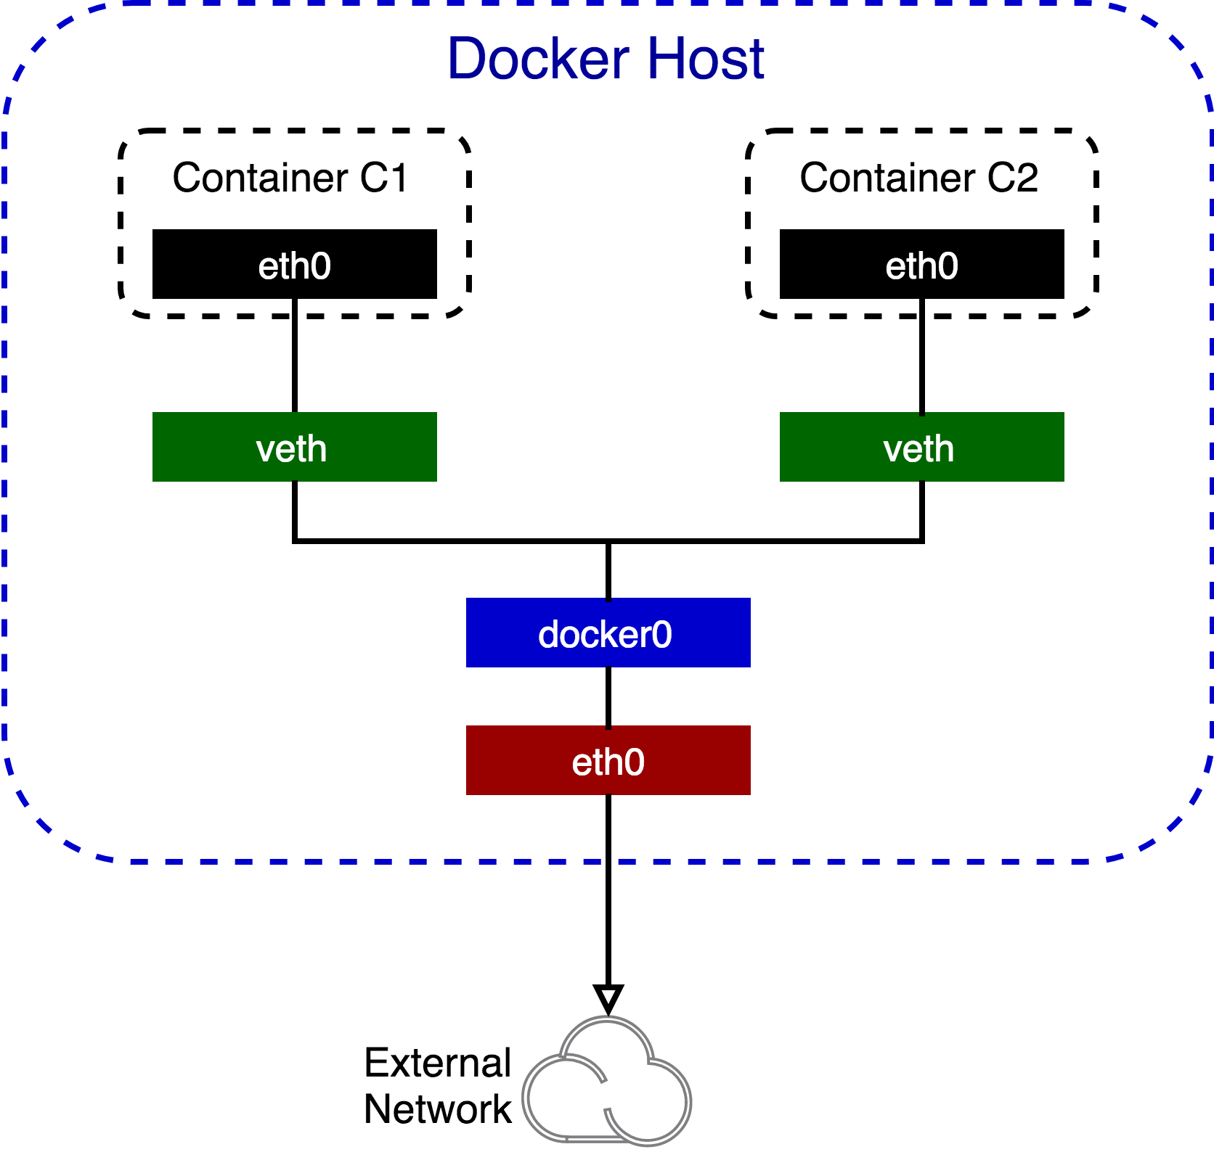
Docker Network Model
Docker by Default
Uses host-private
A virtual bridge is created docker0 allocated with a subnet from one of the private address blocks
For each Docker container, it allocates a veth (virtual ethernet device) and attaches it to the bridge
The veth is mapped to appear as eth0 in the container
This interface is given an IP address from the bridge address range
Only containers (by default) can communicate with each other
For Docker containers to communicate across nodes, ports on the host must be allocated (on the host’s IP) that are in turn forwarded / proxied to the containers
Notes:
Redraw the pic and then add something about network namespace

Slide 4
Kubernetes Network Model
Kubernetes Network Fundamentals
All pods can communicate with all other pods without NAT
All pods can communicate with all containers (and vice-versa) without NAT
The IP the pod sees itself as is the same IP that the others see it as
K8s applies addresses at the pod, contains within a pod share their network namespaces and IP address and thus can communicate via localhost
Containers with the pod must coordinate port usage
Seeking to cut through the complications of the Docker Network Model
Notes:
Coordinating ports across multiple developers is very difficult to do at scale and exposes users to cluster-level issues outside of their control. Dynamic port allocation brings a lot of complications to the system - every application has to take ports as flags, the API servers have to know how to insert dynamic port numbers into configuration blocks, services have to know how to find each other, etc. Rather than deal with this, Kubernetes takes a different approach.

Slide 5

Project Calico
A new approach to virtual networking and network security for containers, VMs, and bare metal services, that provides a rich set of security enforcement capabilities running on top of a highly scalable and efficient virtual network
The calico/node Docker container runs on the Kubernetes master and each Kubernetes node in the cluster
The calico-cni plugin integrates directly with the Kubernetes kubelet process on each node to discover which pods have been created, and adds them to Calico networking
The calico/kube-policy-controller container runs as a pod on top of Kubernetes and implements the NetworkPolicy API
Calico makes use of Layer 3
Calico network policy enforcement ensures that the only packets that flow to and / or from a workload are the ones the developer expects
Notes:
Addressing Routing and Traffic Control
Layer 3: Network Layer[edit]
The network layer provides the functional and procedural means of transferring variable length data sequences (called packets) from one node to another connected in "different networks". A network is a medium to which many nodes can be connected, on which every node has an address and which permits nodes connected to it to transfer messages to other nodes connected to it by merely providing the content of a message and the address of the destination node and letting the network find the way to deliver the message to the destination node, possibly routing it through intermediate nodes. If the message is too large to be transmitted from one node to another on the data link layer between those nodes, the network may implement message delivery by splitting the message into several fragments at one node, sending the fragments independently, and reassembling the fragments at another node. It may, but does not need to, report delivery errors.
Message delivery at the network layer is not necessarily guaranteed to be reliable; a network layer protocol may provide reliable message delivery, but it need not do so.
A number of layer-management protocols, a function defined in the management annex, ISO 7498/4, belong to the network layer. These include routing protocols, multicast group management, network-layer information and error, and network-layer address assignment. It is the function of the payload that makes these belong to the network layer, not the protocol that carries them.^{[6]}

Slide 6
Kubernetes network concepts
CNI is responsible for providing a network fabric for the containers to communicate with each other across the cluster. The container orchestration system runs the plug-in provided by the CNI providers to integrate or implement different network infrastructure technologies.
Calico Network L3 based plug-in. Calico uses the Border Gateway Protocol (BGP) to build routing tables that facilitate communication among agent nodes. Through the use of this protocol, Calico networks offer better performance and network isolation.
VMware NSX-T L2 & L2 plug-in. NSX-T is a network virtualization and security platform that automates the implementation of network policies, network objects, network isolation, and micro segmentation.
Proxy Node (Ingress controller) Transmits external request to the services created inside your cluster.
Network Policy The network policy specifies how a pod is allowed to communicate with others. Network policy controllers convert the requirements and restrictions of the network policies that are retrieved from the Kubernetes API into the network infrastructure.
Notes:
A container needs at least one network interface to communicate with other containers or endpoints.
In Kubernetes, the container network is extended across the cluster and governs how the network traffic happens across the nodes in the cluster. From the application developer point of view, all of the containers in a Kubernetes cluster are on a flat subnet.
When a container is started, a logical network interface is provided inside the container through one end of a veth pair in the container's network namespace. The other end of the veth pair is presented in the default network namespace on the worker node. The veth pair end on the node can be presented either as a logical interface or an interface on a layer-2 bridge depending on the underlying networking technology.
https://www.ibm.com/support/knowledgecenter/SSBS6K_3.1.1/manage_network/container_networking.html
https://www.ibm.com/support/knowledgecenter/SSBS6K_3.1.1/manage_network/network_policy.html

Slide 7
Network Policy
Policy Based Micro-Segmentation

Slide 8
Policy Driven Network Security
Calico Fundamentals for Kubernetes
Perimeter security alone is insufficient
Calico builds upon and extends the capabilities of the platform
Calico enables greater granularity in defining allowable network connections passing this role to developer / operator
Rules are implemented on each node dynamically during the deployment of workload
“A micro-firewall for every workload” –Project Calico

Slide 9
Part 1: Securing with Network Policy
Scenario:
With the default behavior all pods in all namespaces can communicate with each other
We enable isolation by applying the ”default-deny” (selects all pods and provides no allowable defined communication)
Finally, ingress is defined for the nginx replicaset pods for traffic coming from pods labeled “access”
Note: The services in the drawing are logical representations. Connectivity happens from pod to pod. The other namespace represents theoretical workload deployed to your cluster.

Slide 10
Part 2: Stars Demo
Scenario:
With the default behavior all pods can communicate with each other
We enable isolation
Communication is re-allowed from the Front-End to the Back-End
Finally, is re-allowed from Client to the Frong-End

Slide 11
Part 2: Stars Demo
Scenario:
Deny ingress to the NGINX pod
Enable ingress to the NGINX pod
Disable all egress for the busybox pod
Enable only egress to NGINX from busybox

Slide 12
http://ibm.biz/ThinkLab4597
Lab Code: pear4597

Slide 13
®

